Slide 1
Movie Genre Prediction Model
Group 8
Group Members:
Faria Tasnim
Siddharth Sharma
Krutiben Pareshbhai Bhakta
Sravan Kumar Bollepalli

Slide 2
Workflow
Problem Statement
Data Overview
Pre-processing of Data
Analysis of Data
Result Interpretation
Conclusion

Slide 3

Problem Statement
“The aim of this project is to predict whether the movie genre is Drama or not.”
Movie genre
Drama: 1
Not Drama:0

Slide 4
Data Overview
This dataset includes 3 raw files:
movies.csv: The file contains 23,498 rows and 3 columns (movieId, title and genres).
movie_story_student_file.csv: The file contains 20,000 rows and 2 columns (movie_id, story).
movie_story_evaluation_file.csv: The file contains 3,498 rows and 2 columns (movie_id, story).

Slide 5
Data Cleaning and Pre-processing
Removing the missing values from the dataset:
Removed unwanted data such as ‘no genres listed’ , 'No overview found.’ and 'No movie overview available.’ from these files.
Removing the unwanted characters from the dataset:
Removed unwanted characters, white-spaces and symbols such as “\xe2\x80\x93”, /s from the story column.
Added new categorical column “DramaGenre” :
Created a new dataframe “DramaGenre” which represents binary values (1: if movie genre is drama else 0).

Slide 6
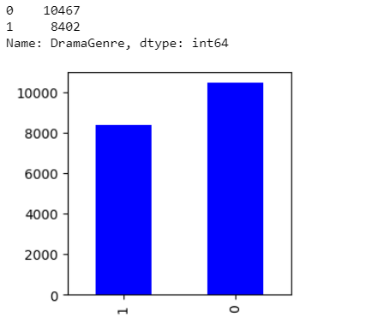
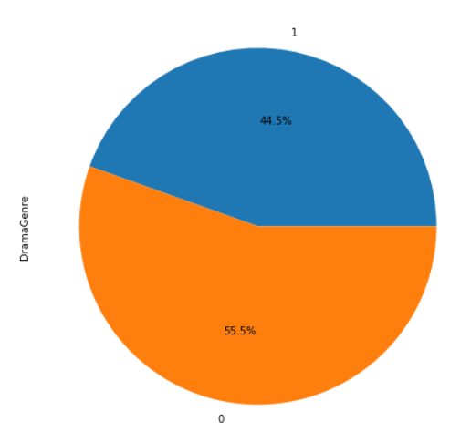
Data Visualization
Using data visualization, we will try to find the patterns present in the data.
The bar chart shows that the total number of non-drama movies is more in number as compared to the drama genre.
The pie chart represents the percentage of drama and non-drama. Here, we have 44.5% of drama genre movies and 55.5% of non-drama genre movies.

Slide 7
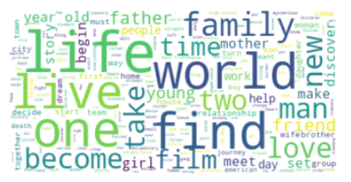
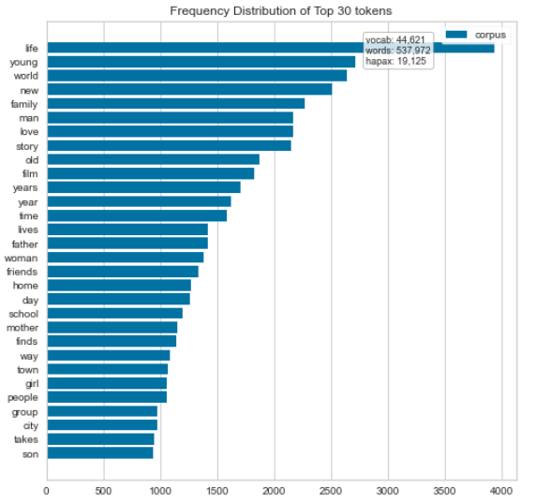
Data Visualization- Continued
Word cloud represents the words that have a high frequency of occurrence in our dataset. Usually, the bigger and bolder the word appears, the more often mentioned within a given text and the more important it is which depicts that life, family, live, one, world and find are some of the more frequent appearing words in our dataset.
We have used the term frequency to examine the importance of words in a text or set of texts by measuring how often certain words appear. We can explain that "life" word is coming almost 4000 times in our dataset which is the highest number.

Slide 8
Text Pre-processing
Removing stop words: Removed all stop words which is not useful such as a, are, etc.
Stemming: We have made a version of main dataset after applying stemming on the story column(story_stem).
Lemmatization: We have made another version of the main dataset after applying lemmatization to the story column(story_lemma).

Slide 9
Text Pre-processing- Cont.
We have performed the following techniques using stemming and lemmatization:
Count Vectorizer
TF-IDF
Truncated SVD

Slide 10
Different Classifier Models Used
We have used 6 different supervised learning techniques to build the models. Following are the classifiers to build the model:
Logistic Regression
KNN
Random Forest
SGD Classifier
Multinomial Naive Bayes
Decision Tree

Slide 11
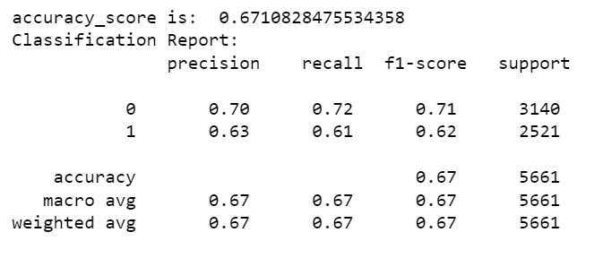
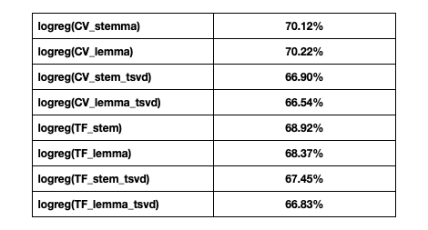
Analysis of Model Results
Logistic Regression Model:
We also performed the benchmark model using logistic regression before applying any text analysis techniques and achieved accuracy of 67.10%.
Trained and built 8 different logistic regression models to test different scenarios of stemming and lemmatization.
Using CV_stemma (stemming) and CV_lemma (lemmatization) in logistic regression model, we got the maximum accuracy of around 70%.
Accuracy of logreg(CV_lemma) model is highest among all 8 models equivalent to 70.22%.

Slide 12
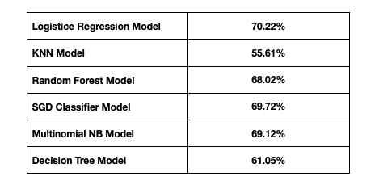
Analysis of Model Results
As CV_lemma has the best results, so we have run all 6 the models using CV_lemma next.
We got almost similar results for RF, SGD classifier and Multinomial NB model but Logistic regression is giving the highest accuracy among all 6 models.
Highest mean accuracy score acquired for logistic regression model is 70.22%.

Slide 13
Exploring Text Analysis Technique Further
We also wanted to explore further by applying Topic Modeling Techniques(LDA), does our model accuracy improves or not. But the result doesn't improve and the mean accuracy is quite low around 59%.
We have also implemented Word Embedding method but this techniques also doesn't enhance our accuracy score, providing a mean accuracy of 55.47%.

Slide 14
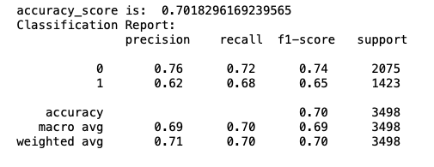
Output of Final Prediction
We have applied lemmatization and count vectorization on entire main dataset and evaluation dataset.
Trained the best model (logistic regression) with main dataset and conducted prediction on evaluation dataset.
Accuracy of our final prediction is 70.18%.

Slide 15
Conclusion
Using logistic regression with count vectorized lemmatized version of the data, we obtained best results.
If we had more train data then, overall performance of our model can be improved.

Slide 16
Any Questions???
Thank You

